Slide 1
Transcatheter Aortic Valve Replacement with a Self-Expanding Prosthesis or Surgical Aortic Valve Replacement in Intermediate-Risk Patients:
First Results from the SURTAVI Clinical Trial
Michael J. Reardon, MD
For the SURTAVI Investigators

Slide 2
Disclosure Statement of Financial Interest
Within the past 12 months, I or my spouse/partner have had a financial interest/arrangement or affiliation with the organization(s) listed below.
Financial Relationship | Company
Consultant (fees paid to institution) | Medtronic
2

Slide 3
Background
Self-expanding transcatheter aortic valve replacement (TAVR) is preferred to medical therapy in patients with severe, symptomatic aortic stenosis deemed prohibitive for surgical aortic valve replacement (SAVR)¹, and is superior in patients at high risk for operative mortality at 30 days.²
The comparative efficacy of TAVR and SAVR has been less well studied in aortic stenosis patients at lower surgical risk.
¹Popma J, Adams D, Reardon M, et al. J Am Coll Cardiol 2014
²Adams D, Popma J, Reardon M, et al. New Engl J Med 2014
3

Slide 4
Objective
To assess the safety and efficacy of TAVR with the self-expanding valve vs. surgical AVR in patients with symptomatic, severe aortic stenosis at intermediate surgical risk
4

Slide 5
Trial Design
Intermediate Surgical Risk
Predicted risk of operative mortality ≥3% and <15%
Heart Team Evaluation
Assess inclusion/exclusion
Risk classification
Screening Committee
Confirmed eligibility
Randomization
Stratified by need for revascularization
Baseline neurological
assessments
TAVR
SAVR
TAVR only
TAVR + PCI
SAVR only
SAVR + CABG
5

Slide 6
Study Endpoints
Primary endpoint
All-cause mortality or disabling stroke at 24 months
Key secondary endpoints
Safety:
All-cause mortality
All stroke
Aortic valve reintervention
Major vascular complications
Life-threatening or major bleeding
Pacemaker implantation
Major adverse cardiovascular and cerebrovascular events (MACCE)
Efficacy:
Mean gradient
EOA
Moderate/severe AR
Quality of life:
KCCQ
6

Slide 7
Study Administration
Principal Investigators: Patrick Serruys*, Nicolas Van Mieghem*, Michael Reardon*, Jeffrey Popma*, A. Pieter Kappetein*, David Adams, Stephan Windecker, Rüdiger Lange, Thomas Walther
Steering Committee Michael Reardon, Patrick Serruys, Nicolas Van Mieghem, Jeffrey Popma, A. Pieter Kappetein, David Adams, Blase Carabello, Eberhard Grube, Rüdiger Lange, Nicolo Piazza, Thomas Walther, Stephan Windecker, Steven Yakubov, Mathew Williams, Lars Søndergaard, Thomas Gleason, G. Michael Deeb
Echo Core Laboratory J. Oh, Mayo Clinic, Rochester, MN
Data & Safety Monitoring Board D.P. Faxon, Prof. J.G.P. Tijssen, W.L. Holman, R.J. van Oostenbrugge, Cardialysis, Rotterdam, Netherlands
Clinical Events Committee E. Jansen, H. Garcia-Garcia, W. Rutsch, C. Hanet, R. O. Roine, G. Amoroso, M. De Bonis, G. Andersen, J. Pomar, Cardialysis, Rotterdam, Netherlands
Statistical Design and Analysis Andrew Mugglin, Paradigm Biostatistics, LLC
Sponsor Medtronic
* Executive Committee members

Slide 8
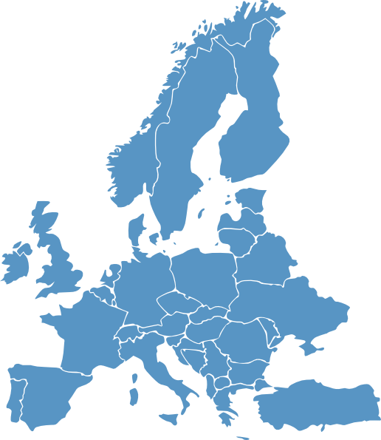
Participating Sites – Canada and Europe
17 sites in Europe
Erasmus Medical Center
Rotterdam, Netherlands
Amphia Hospital
Breda, Netherlands
Karolinska University Hospital
Stockholm, Sweden
Glenfield Hospital
Leicester, UK
Medisch Centrum Leeuwarden
Leeuwarden, Netherlands
Montreal Heart Institute
Montreal, Quebec
Leeds General Infirmary
Leeds, UK
Rigshospitalet
Copenhagen, Denmark
St. George’s Hospital
London, UK
St. Antonius Ziekenhuis
Nieuwegein, Netherlands
University Hospital
Bonn, Germany
Royal Sussex County Hospital
Brighton, UK
German Heart Center
Munich, Germany
Toronto General Hospital
Toronto, Ontario
McGill Univ Health Center/Glen Hosp
Montreal, Quebec
Hospital Universitario Central de Asturias
Oviedo, Spain
Heart Centre - Bad Krozingen
Bad Krozingen, Germany
Universitatsspital Zurich
Zurich, Switzerland
London Health
Sciences Center
London, Ontario
Sunnybrook Health Sciences Centre
Toronto, Ontario
Inselspital - Universitatsspital Bern
Bern, Switzerland
5 sites in Canada
Hospital Universitario Virgen de la Victoria
Malaga, Spain
8

Slide 9
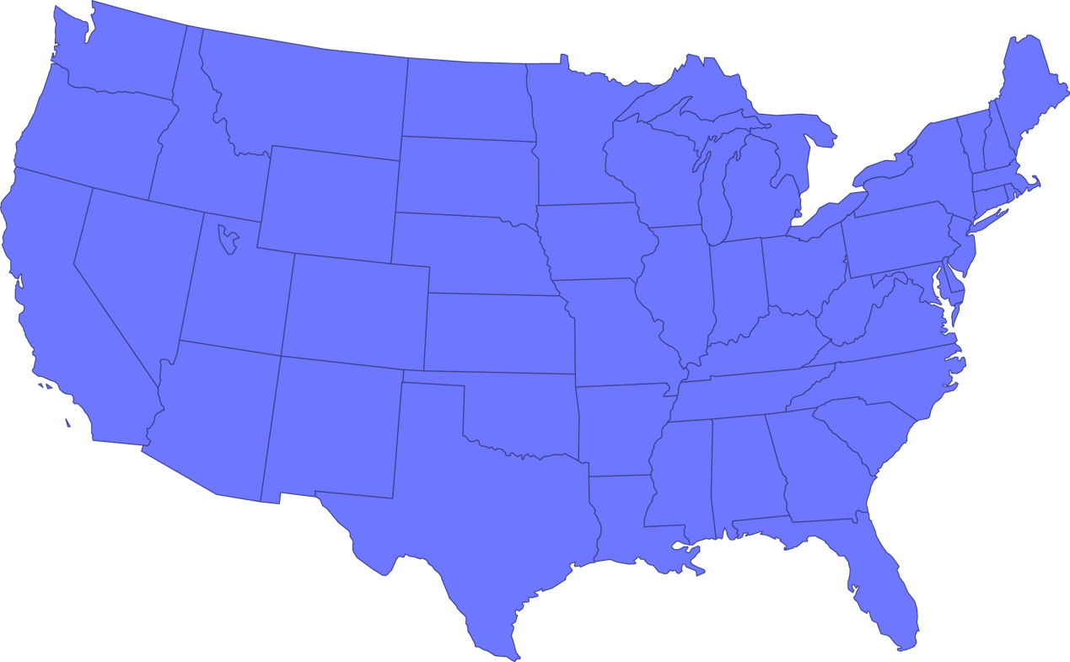
Participating Sites – United States
U of Michigan
Ann Arbor, MI
Detroit Medical Center
Henry Ford
Detroit, MI
Beth Israel
Boston, MA
St. John
Detroit, MI
Fletcher Allen
Burlington, VT
Hartford
Hartford, CT
Spectrum
Grand Rapids, MI
Abbott NW
Minneapolis, MN
Yale
New Haven, CT
Mayo Clinic
Rochester, MN
Cooper U
Camden, NJ
Winthrop
Mineola, NY
St. Francis
Roslyn, NY
Stanford U
Stanford, CA
UH Case
Cleveland, OH
U of Rochester
Rochester, NY
VA Palo Alto
VA Palo Alto, CA
Aurora St. Lukes
Milwaukee, WI
North Shore
Manhasset, NY
Alegent Creighton
Omaha, NE
Riverside Methodist
Columbus, OH
Loyola
Maywood, IL
Pitt
Pittsburg, PA
Columbia
Mount Sinai
Lenox Hill NYU-Langone
New York, NY
Intermountain
Murray, UT
Iowa Heart
Des Moines, IA
U of Kansas
Kansas City, KS
Ohio State
Columbus, OH
El Camino
Mountain View, CA
St. Vincent
Indianapolis, IN
Good Samaritan
Cincinnati, OH
St. Luke’s MAHI
Kansas City, MO
Morristown
Morristown, NJ
Kaiser Permanente
Los Angeles, CA
Duke
Durham, NC
HUP
Philadelphia,, PA
Oklahoma Heart
Kansas City, KS
Wake Forest
Winston Salem, NC
USC
Los Angeles, CA
Vanderbilt
Nashville, TN
Geisinger
Danville, PA
Baylor Heart and
Vascular
Dallas, TX
Baptist Memorial
Memphis, TN
Carolinas
Charlotte, NC
Pinnacle
Harrisburg, PA
Cedars Sinai
Los Angeles, CA
Banner
Phoenix, AZ
Piedmont
Atlanta, GA
Emory University
Atlanta, GA
Johns Hopkins
Baltimore, MD
Bon Secours
Richmond, VA
Scripps
La Jolla, CA
Washington Hospital Center
Washington, DC
The Heart Hospital – Baylor Plano
Plano, TX
Morton Plant
Clearwater, FL
Queens Medical
Honolulu, HI
Sentara
Norfolk, VA
Methodist
Houston, TX
CV Institute
of the South
Houma, LA
65 sites in the United States
Delray Medical
Center
Delray Beach, FL
U of Miami
Miami, FL
9

Slide 10
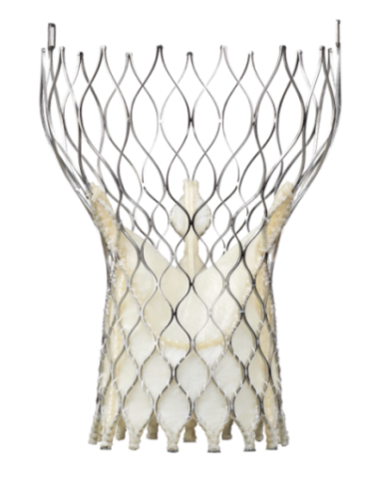
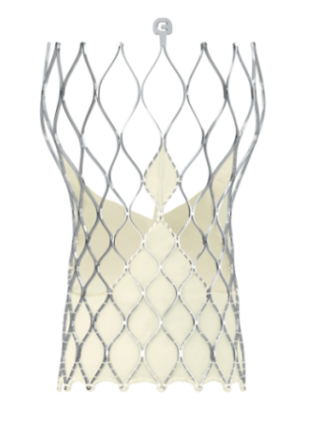
Study Timeline
2012 2013 2014 2015 2016
April
First patient enrolled
June 19, 2012
Enrollment completed
June 30, 2016
Primary endpoint
assessment
Dec 2016
CoreValve: 23, 26 and 29 mm (US)
Evolut R (US)
CoreValve: 23, 26 and 29 mm (CAN, EU)
CoreValve: 31 mm (US, CAN, EU)
94% TF
4% DA
2% SCA
CoreValve (n=724)
Evolut R (n=139)
10

Slide 11
Key Inclusion Criteria
Severe aortic valve stenosis defined by an initial aortic valve area of ≤1.0 cm² or aortic valve area index <0.6 cm²/m², AND a mean gradient >40 mmHg or Vmax >4 m/sec, at rest or with dobutamine provocation in patients with a LVEF <55%, or Doppler velocity index <0.25 by resting echocardiogram
Heart team agreement that predicted 30-day surgical mortality risk is ≥3% and <15% based on STS PROM and overall clinical status including frailty, disability and comorbidity factors
NYHA functional class II or greater
11

Slide 12
Key Exclusion Criteria
Contraindication for placement of a bioprosthetic valve
A known hypersensitivity or contraindication to all anticoagulation/ antiplatelet regimens
Any PCI or peripheral intervention within 30 days of randomization
Symptomatic carotid or vertebral artery disease or successful treatment of carotid stenosis within six weeks of randomization
Recent cerebrovascular accident or transient ischemic attack
Acute MI within 30 days
Multivessel CAD with Syntax score >22
Severe liver, lung or renal disease
Unsuitable anatomy including native aortic annulus <18 mm or >29 mm
Severe mitral or tricuspid regurgitation
Congenital bicuspid or unicuspid valve verified by echo
12

Slide 13
Definitions
Stroke assessment
All the patients were seen by a trained neurologist or stroke specialist at baseline.
Follow-up neurological assessments were done at discharge, 30 days, 6, 12, 18 and 24 months.
Neurologic events were adjudicated by a neurologist on the CEC.
Stroke was defined according to the VARC-2 criteria.
Disabling stroke was defined as a modified Rankin score of ≥2 at 90 days and an increase in at least 1 mRS category.
Life-threatening or disabling bleeding was defined using BARC criteria.
13

Slide 14
Statistical Methods
The SURTAVI trial utilized a novel Bayesian statistical methodology.
The primary objective of the trial was to show that TAVR is noninferior to SAVR for all-cause mortality or disabling stroke at 24 months with a noninferiority margin of 0.07.
The sample size of 1600 attempted implants assumed a 17% incidence of the primary endpoint in surgery patients.
The primary and secondary endpoints were evaluated in the modified intention-to-treat (mITT) population.
14

Slide 15
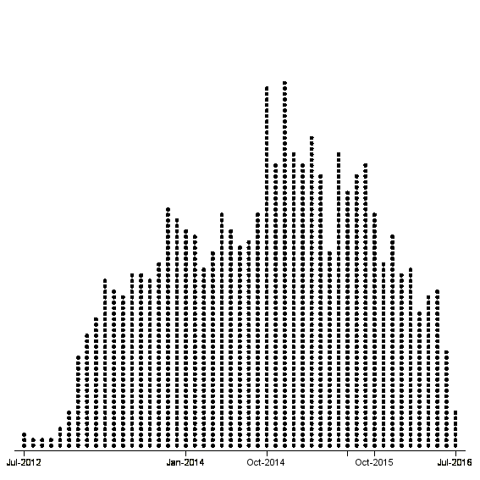
Bayesian Analysis of the 24-Month Primary Endpoint
A pre-specified interim analysis occurred when 1400 patients reached 12-month follow-up.
Observed 24-month outcomes were used to inform modeling.
Subjects who had not reached 24-month follow-up had their outcomes imputed using their last known event status.
Combining imputed and observed data, the posterior distribution of the difference in 24-month event rates was calculated.
Analysis Trigger
Complete 24 month follow-up
Complete 12 month FU
<12 month FU
Information used to inform modeling
Final outcomes modeled
Interim Bayesian Analysis of the 2Year Primary Endpoint timed to occur when 1400 subjects have been followed for 12 months
Analysis using modeling to include all patient data
N=1400
~35%
~50%
~15%
Number of Subjects
2012
2013
2014
2015
2016
Attempted Procedure Date
15

Slide 16
Standard of Success for Noninferiority of the Primary Endpoint
Posterior Distribution of the Difference (TAVR rate – SAVR rate)
Standard of Success:
PP(π_{T} - π_{C}< 0.07) > 0.971
(0.971 chosen to keep α ≤ 0.05)
PP = Posterior Probability; π_{T} = TAVR rate; π_{C} = SAVR rate
16

Slide 17
Patient Flow
1,746 patients randomized
TAVR ITT group: N=879
SAVR ITT group: N=867
15 not attempted:
- 4 died
- 6 withdrew consent
- 5 physician withdrew
71 not attempted:
- 4 died
- 43 withdrew consent
23 physician withdrew
1 lost to follow-up
TAVR mITT* group: N=864
SAVR mITT* group: N=796
2 not implanted
1 went to SAVR
2 surgical patients received TAVR
1 not implanted
2 went to TAVR
1 TAVR patient received SAVR
TAVR implanted group: N=863
SAVR implanted group: N=794
*The modified intention-to-treat (mITT) population includes all subjects with an attempted procedure
17
Notes:
TAVR not implanted (n=2)
(00328-007) Subject peri-operative developed a pericardial tamponade with pericardial effusion. A pericardiocentesis was performed prior to TAVR procedure. Due to the instability of the subject the procedure was aborted. Subject exited from study after aborted procedure
(00437-058) Evolut R implant not successful resulted in valve repositioning with the snare and retrieval due to severe AI. Sapien 3 was implanted.
SAVR not implanted(n=1_
(00176-020) had SAVR index procedure, but procedure was aborted due to porcelain aorta and exited study after aborted procedure
TAVR implanted with SAVR(n=1)
(00270-051) experienced a valve recapture following complete release of the valve, (due to a deep implant and significant paravalvular leak). During recapture, very rapid pericardial fusion was noted; subject was converted to emergent surgical AVR.
SAVR implanted with TAVR(n=2)
(05001-005) SAVR procedure aborted due to porcelain aorta, TAVI procedure occurred 1 week later
(10100-002) randomized to SAVR but had TAVI index procedure and implanted with CoreValve

Slide 18
Baseline Characteristics*
n (%) or mean ± SD | TAVR (N=864) | SAVR (N=796)
Age, years | 79.9 ± 6.2 | 79.7 ± 6.1
Male sex | 498 (57.6) | 438 (55.0)
Body surface area, m² | 1.9 ± 0.2 | 1.9 ± 0.2
STS PROM, % | 4.4 ± 1.5 | 4.5 ± 1.6
Logistic EuroSCORE, % | 11.9 ± 7.6 | 11.6 ± 8.0
Diabetes mellitus | 295 (34.1) | 277 (34.8)
Serum creatinine >2 mg/dl | 14 (1.6) | 17 (2.1)
Prior stroke | 57 (6.6) | 57 (7.2)
Prior TIA | 58 (6.7) | 46 (5.8)
Peripheral vascular disease | 266 (30.8) | 238 (29.9)
Permanent pacemaker | 84 (9.7) | 72 (9.0)
*mITT population; no significant difference in any baseline characteristics
18

Slide 19
Baseline Cardiac Risk Factors*
n (%) | TAVR (N=864) | SAVR (N=796)
Coronary artery disease | 541 (62.6) | 511 (64.2)
Prior CABG | 138 (16.0) | 137 (17.2)
Prior PCI | 184 (21.3) | 169 (21.2)
Prior myocardial infarction | 125 (14.5) | 111 (13.9)
Congestive heart failure | 824 (95.4) | 769 (96.6)
History of arrhythmia | 275 (31.8) | 250 (31.4)
Atrial fibrillation | 243 (28.1) | 211 (26.5)
NYHA Class III/IV | 520 (60.2) | 463 (58.2)
*mITT population; no significant difference in any baseline characteristics
19

Slide 20
Baseline Frailty, Disabilities and Comorbidities*
n (%) or mean ± SD | TAVR (N=864) | SAVR (N=796)
Body mass index <21 kg/m² | 20 (2.3) | 21 (2.6)
Falls in past 6 months | 102 (11.8) | 101 (12.7)
5 meter gait speed >6 s | 428 (51.8) | 403 (52.9)
6 minute walk test (meters) | 254.1 ± 115.8 | 260.9 ± 117.9
Grip strength below threshold | 519 (62.5) | 490 (63.1)
Does not live independently | 18 (2.1) | 22 (2.8)
Chronic lung disease (mod/severe) | 115 (13.3) | 106 (13.3)
Home oxygen | 18 (2.1) | 21 (2.6)
Cirrhosis of the liver | 4 (0.5) | 5 (0.6)
Immunosuppressive therapy | 64 (7.4) | 68 (8.5)
*mITT population; no significant difference in any baseline characteristics
20

Slide 21
RESULTS
21

Slide 22
All-Cause Mortality or Disabling Stroke
24 Months
TAVR | SAVR
12.6% | 14.0%
No. at Risk
SAVR
796 |  | 674 |  | 555 |  | 407 |  | 241
864 |  | 755 |  | 612 |  | 456 |  | 272
TAVR
22

Slide 23
Primary Endpoint
Posterior Probability
distribution
Noninferiority margin
PP >0.999
meets
noninferiority
Difference in 24-month incidence
TAVR - SAVR
TAVR (95% CI) | SAVR (95% CI) | Difference (95% CI)
12.6% (10.2%, 15.3%) | 14.0% (11.4%, 17.0%) | –1.4% (–5.2%, 2.3%)
23

Slide 24
All-Cause Mortality
TAVR | SAVR
30 Day
SAVR 1.7% O:E 0.38
TAVR 2.2% O:E 0.50
No. at Risk
SAVR
796 |  | 690 |  | 569 |  | 414 |  | 249
864 |  | 762 |  | 621 |  | 465 |  | 280
TAVR
24

Slide 25
All-Cause Mortality
TAVR | SAVR
24 Months
TAVR | SAVR | 95% CI for Difference
11.4% | 11.6% | -3.8, 3.3
30 Day
SAVR 1.7% O:E 0.38
TAVR 2.2% O:E 0.50
No. at Risk
SAVR
796 |  | 690 |  | 569 |  | 414 |  | 249
864 |  | 762 |  | 621 |  | 465 |  | 280
TAVR
25

Slide 26
Instantaneous Hazard of Mortality
SURTAVI TAVR
SURTAVI SAVR
High-Risk TAVR
High-Risk SAVR
Guadiani V. Deeb GM, Popma JJ, et al. J Thorac Cardiovasc Surg 2017.

Slide 27
Disabling Stroke
24 Months
TAVR | SAVR | 95% CI for Difference
2.6% | 4.5% | -4.0, 0.1
No. at Risk
SAVR
796 |  | 674 |  | 555 |  | 407 |  | 241
864 |  | 755 |  | 612 |  | 456 |  | 272
TAVR
27

Slide 28
Procedural Characteristics
Characteristic, mean ± SD | TAVR (n=864) | SAVR (n=796) | 95% CI for difference
Procedure time, min | 52.3 ± 32.7 | 203.7 ± 69.1 | (-156.7, -146.1)
Total time in cath lab or OR, min | 190.8 ± 61.3 | 295.5 ± 81.6 | (-111.7, -97.6)
Aortic cross-clamp time, min | NA | 74.3 ± 30.4 | NA
CPB time, min | NA | 97.8 ± 39.3 | NA
Length of index procedure hospital stay, days | 5.75 ± 4.85 | 9.75 ± 8.03 | (-4.65, -3.36)
Length of ICU stay, hours | (n=767) 48.6 ± 44.0 | (n=778) 70.4 ± 96.2 | (-29.3, -14.3)
28

Slide 29
30-Day Safety and Procedure-related Complications
 | TAVR (N=864) | SAVR (N=796) | 95% CI for Difference
All-cause mortality or disabling stroke | 2.8 | 3.9 | -2.8, 0.7
All-cause mortality | 2.2 | 1.7 | -0.9, 1.8
Disabling stroke | 1.2 | 2.5 | -2.6, 0.1
All stroke | 3.4 | 5.6 | -4.2, -0.2
Overt life-threatening or major bleeding | 12.2 | 9.3 | -0.1, 5.9
Transfusion of PRBCs* - n (%) 0 units 2 – 4 units ≥ 4 units | 756 (87.5) 48 (5.6) 31 (3.6) | 469 (58.9) 136 (17.1) 101 (12.7) | 24.4, 32.5 -14.5, -8.5 -11.7, -6.5
Acute kidney injury, stage 2-3 | 1.7 | 4.4 | -4.4, -1.0
Major vascular complication | 6.0 | 1.1 | 3.2, 6.7
Cardiac perforation | 1.7 | 0.9 | -0.2, 2.0
Cardiogenic shock | 1.1 | 3.8 | -4.2, -1.1
Permanent pacemaker implant | 25.9 | 6.6 | 15.9, 22.7
Atrial fibrillation | 12.9 | 43.4 | -34.7, -26.4
*Percentage rates, all others are Bayesian rates
29

Slide 30
All-Cause Mortality by Pacemaker Implantation
PPI Prior to Procedure
With New PPI
Without New PPI
P-value (log-rank) = 0.32
16.3%
10.5%
10.1%
No. at Risk
PPI Prior
87 |  | 74 |  | 59 |  | 46 |  | 28
217 |  | 198 |  | 164 |  | 121 |  | 56
559 |  | 491 |  | 400 |  | 300 |  | 197
With New PPI
Without New PPI
30

Slide 31
Clinical Outcomes* at 12 and 24 Months
12 Months |  |  |  | 24 Months
 | TAVR | SAVR | 95% CI for Difference | TAVR | SAVR | 95% CI for Difference
All-cause mortality or disabling stroke | 8.1 | 8.8 | -3.5, 2.1 | 12.6 | 14.0 | -5.2, 2.3
All-cause mortality | 6.7 | 6.8 | -2.7, 2.4 | 11.4 | 11.6 | -3.8, 3.3
All stroke | 5.4 | 6 .9 | -3.9, 0.9 | 6.2 | 8.4 | -5.0, 0.4
Disabling stroke | 2.2 | 3.6 | -3.1, 0.4 | 2.6 | 4.5 | -4.0, 0.1
TIA | 3.2 | 2.0 | -0.4, 2.8 | 4.3 | 3.1 | -0.9, 3.2
Myocardial infarction | 2.0 | 1.6 | -0.9, 1.8 | 2.8 | 2.2 | -1.1, 2.4
Aortic valve re-intervention | 2.1 | 0.5 | 0.4, 2.7 | 2.8 | 0.7 | 0.7, 3.5
Aortic valve hospitalization | 8.5 | 7.6 | -1.8, 3.6 | 13.2 | 9.7 | 0.1, 7.0
MACCE | 13.2 | 12.8 | -2.9, 3.7 | 18.6 | 18.6 | -4.2, 4.2
*All are reported as Bayesian rates
31

Slide 32
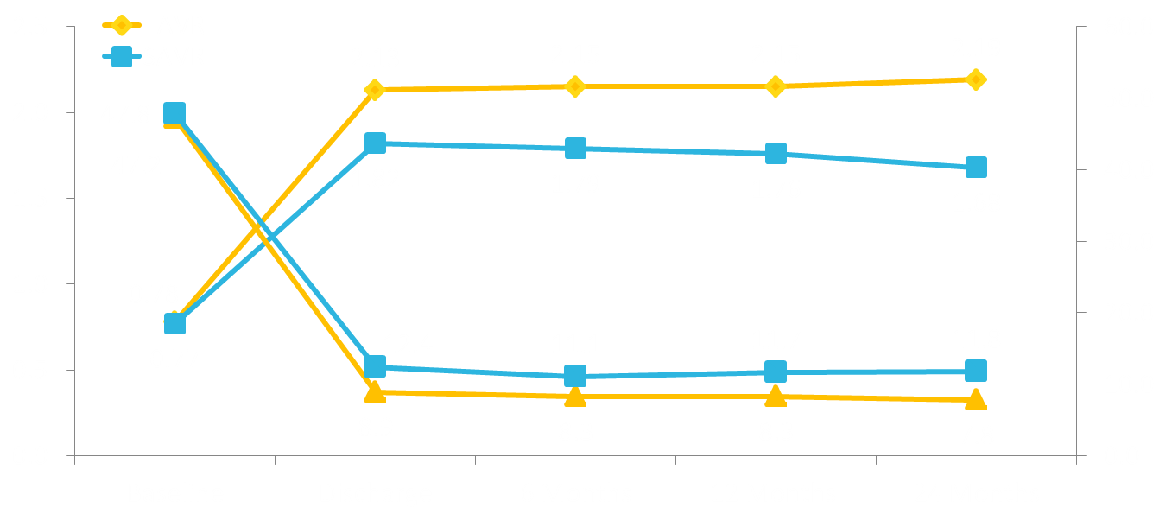
Hemodynamics*
TAVR had significantly better valve performance over SAVR at all follow-up visits
Aortic Valve Area, cm²
AV Mean Gradient, mm Hg
*Core lab adjudicated
32

Slide 33
NYHA Functional Class
Percentage of Patients
0.8%
33

Slide 34
KCCQ Summary Score Over Time
Patients recover quality of life sooner after TAVR than SAVR
KCCQ Summary Score
TAVR | 18.4 ± 22.8 | 21.8 ± 22.3 | 20.9 ± 22.2
SAVR | 5.9 ± 27.0 | 21.3 ± 22.3 | 20.6 ± 22.2
95% CI for difference | (10.0, 15.1) | (-1.9, 2.8) | (-2.2, 2.9)
Change from Baseline
34

Slide 35
Total Aortic Regurgitation*
* Implanted population, core lab adjudicated
35

Slide 36
All-Cause Mortality or Disabling Stroke at 12 Months
Subgroup | TAVR | SAVR | Hazard Ratios (95% CI) |  | P for Interaction
 | n/N (KM rate at 12 months)
Age |  |  |  |  | 0.82
<80 | 22/352 (6.6) | 21/330 (6.8) | 0.96 (0.53-1.74)
≥80 | 44/512 (9.2) | 45/466 (10.0) | 0.88 (0.58-1.33)
Gender |  |  |  |  | 0.73
Male | 42/498 (9.0) | 38/438 (9.2) | 0.94 (0.61-1.47)
Female | 24/366 (6.9) | 28/358 (8.2) | 0.83 (0.48-1.44)
BMI |  |  |  |  | 0.56
≤30 | 44/527 (8.8) | 41/486 (8.8) | 0.98 (0.64-1.49)
>30 | 22/337 (7.1) | 25/310 (8.6) | 0.79 (0.45-1.40)
LVEF |  |  |  |  | 0.73
≤50 | 10/131 (8.0) | 12/133 (9.3) | 0.81 (0.35-1.88)
>50 | 56/732 (8.2) | 52/657 (8.3) | 0.95 (0.65-1.39)
PVD |  |  |  |  | 0.67
No | 42/598 (7.6) | 45/558 (8.5) | 0.86 (0.56-1.30)
Yes | 24/266 (9.4) | 21/238 (9.3) | 1.00 (0.56-1.80)
0.125
0.25
0.50
1.00
2.00
Favors TAVR
Favors SAVR
36

Slide 37
All-Cause Mortality or Disabling Stroke at 12 Months
Subgroup | TAVR | SAVR | Hazard Ratios (95% CI) |  | P for Interaction
 | n/N (KM rate at 12 months)
Diabetes |  |  |  |  | 0.45
No | 43/569 (8.0) | 47/519 (9.5) | 0.83 (0.55-1.25)
Yes | 23/295 (8.3) | 19/277 (7.3) | 1.10 (0.60-2.02)
Revascularization |  |  |  |  | 0.42
No | 47/695 (7.3) | 50/633 (8.3) | 0.84 (0.56-1.25)
Yes | 19/169 (11.7) | 16/163 (10.3) | 1.15 (0.59-2.23)
STS |  |  |  |  | 0.06
<4 | 12/345 (3.8) | 20/299 (7.2) | 0.50 (0.25-1.03)
≥4 | 54/519 (10.8) | 46/497 (9.5) | 1.11 (0.75-1.65)
Logistic EuroSCORE |  |  |  |  | 0.84
<10 | 31/429 (7.8) | 35/432 (8.7) | 0.87 (0.54-1.41)
≥10 | 35/435 (8.5) | 31/363 (8.8) | 0.93 (0.58-1.52)
5 m gait speed |  |  |  |  | 0.78
≤6 sec | 29/399 (7.9) | 30/359 (9.0) | 0.86 (0.52-1.43)
>6 sec | 33/428 (8.2) | 32/403 (8.1) | 0.95 (0.58-1.54)
0.125
0.25
0.50
1.00
2.00
Favors TAVR
Favors SAVR
37

Slide 38
Summary
SURTAVI met its primary endpoint demonstrating that TAVR with a self-expanding CoreValve or Evolut R bioprosthesis is noninferior to SAVR for all-cause mortality or disabling stroke at 24 months.
38
Notes:
“trigger more aggressive follow-up

Slide 39
Summary
TAVR had significantly less 30 day stroke, AKI, atrial fibrillation and transfusion use and a superior quality of life at 30 days.
TAVR resulted in significantly improved AV hemodynamics with lower mean gradients and larger aortic valve areas than SAVR through 24 months.
SAVR had less residual aortic regurgitation, major vascular complications and fewer new pacemakers.
Need for a new pacemaker after TAVR was not associated with increased mortality.
39
Notes:
“trigger more aggressive follow-up

Slide 40
Conclusion
In SURTAVI, TAVR with the self-expanding valve was safe and effective treatment for patients with symptomatic severe AS at intermediate risk for surgical mortality
IMPLICATIONS
40
Notes:
“trigger more aggressive follow-up

Slide 41
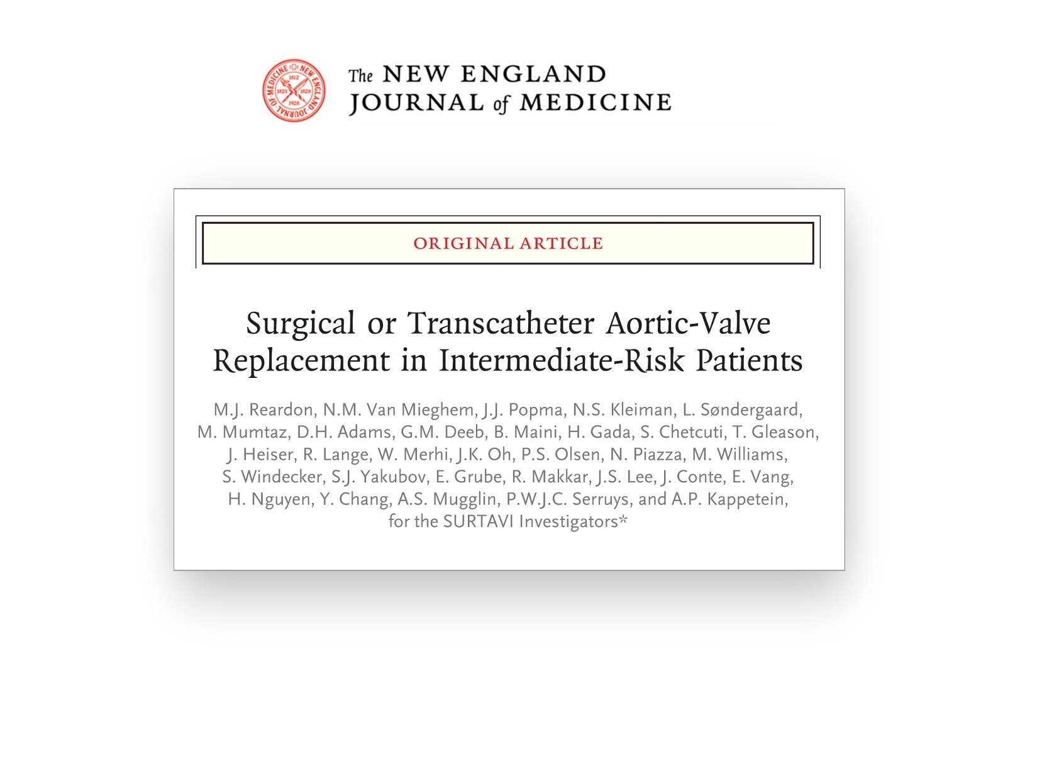

Slide 42
Thank you to all of the SURTAVI patients, site personnel and investigators who made this trial possible

